Slide 1

Principles of Economics
Swagat Kishore Mishra
Lecturer, Dept. of Economics
Email: swagat@bits-goa.ac.in / sayswagat@gmail.com
VOIP: 207 PSRN: 485 CHAMBER: A-301/16
Tel. 0832-2580207 (O) 08879506995 (M)

Slide 2
Monopoly……. Rules?
A monopoly can set its price—it is not a price taker like a competitive firm.
A monopoly’s output is the market output, and the demand curve a monopoly faces is the market demand curve.
Because the market demand curve is downward sloping, the monopoly (unlike a competitive firm) doesn’t lose all its sales if it raises its price.
As a consequence, the monopoly sets its price above marginal cost to maximize its profit.
Consumers buy less at this high monopoly price than they would at the competitive price, which equals marginal cost.

Slide 3
FEATURES:
1. Monopoly profit maximization: Like all firms, a monopoly maximizes its profit by setting its price or output so that its marginal revenue equals its marginal cost.
2. Market power: How much the monopoly’s price is above its marginal cost depends on the shape of the demand curve it faces.
3. Effects of a shift of the demand curve: A shift of the demand curve may have a wider range of effects on a monopoly than on a competitive market.
4. Welfare effects of monopoly: By setting its price above marginal cost, a monopoly creates a deadweight loss.
5. Cost advantages that create monopolies: A firm can use a cost advantage over other firms (due, say, to control of a key input or economies of scale) to become a monopoly.
6. Government actions that create monopolies: Governments create monopolies by establishing government monopoly firms, limiting entry of other firms to create a private monopoly, and issuing patents, which are temporary monopoly rights.
7. Government actions that reduce market power: The welfare loss of a monopoly can be reduced or eliminated if the government regulates the price the monopoly charges or allows other firms to enter the market.

Slide 4
Functions: MR, AR, Price
A firm’s demand curve shows the price, p, it receives for selling a given quantity, q. The price is the average revenue the firm receives, so a firm’s revenue is R = pq.
A firm’s marginal revenue curve depends on its demand curve.
Q1. Based on the above two information and seeking help from the following figure show that a monopoly’s marginal revenue curve lies below its demand curve at any positive quantity because its demand curve is downward sloping.

Slide 5
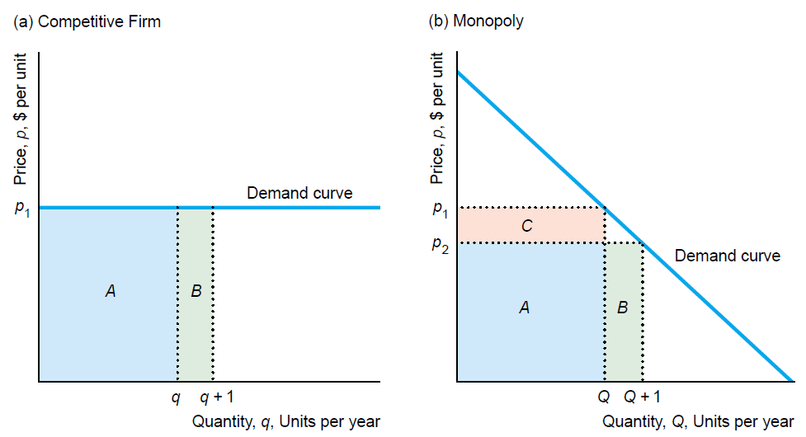
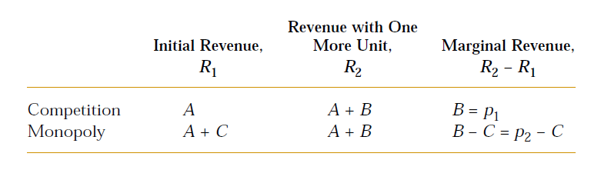

Slide 6
Thus the monopoly’s marginal revenue curve lies below the demand curve at every positive quantity. In general, the relationship between the marginal revenue and demand curves depends on the shape of the demand curve.
For all linear demand curves, the relationship between the marginal revenue and demand curve is the same.
The marginal revenue curve is a straight line that starts at the same point on the vertical (price) axis as the demand curve but has twice the slope of the demand curve, so the marginal revenue curve hits the horizontal (quantity) axis at half the quantity as the demand curve.

Slide 7
Because a monopoly does not have a supply curve, the effect of a shift in demand on a monopoly’s output depends on the shapes of both its marginal cost curve and its demand curve. As a monopoly’s demand curve shifts, price and output may change in the same direction or different directions.
Because a monopoly’s price is above its marginal cost, too little output is produced, and society suffers a deadweight loss. The monopoly makes higher profit than it would if it acted as a price taker. Consumers are worse off, buying less output at a higher price.

Slide 8
A firm may be a monopoly if it controls a key input, has superior knowledge about producing or distributing a good, or has substantial economies of scale.
In markets with substantial economies of scale, the single seller is called a natural monopoly because total production costs would rise if more than one firm produced.
Governments may establish government-owned and –operated monopolies. They may also create private monopolies by establishing barriers to entry that prevent other firms from competing. Nations grant patents, which give inventors monopoly rights for a limited period of time.

Slide 9
Imperfect Market
Imperfect competition is a market situation where individual firms have a measure of control over the price of the commodity in an industry.
a firm that can affect the market price of its output can be classified as an imperfect competitor.
Normally, imperfect competition arises when an industry's output is supplied only by one, or a relatively small number of firms.

Slide 10
Imperfect Market
An imperfect market is a situation where individual firms have some measure of control or discretion over the price of the commodity in an industry
This imperfect competition does not necessarily mean that a firm can arbitrarily put any price on its commodity
an imperfect competitor does not have absolute power over price
Aside from discretion over price, imperfect competitors may or may not have product differentiation/variation

Slide 11
Demand curve faced by firm
The firm under an imperfect market faces the market demand curve or part of it.
In either case, the firm faces a downward sloping demand curve
This implies that if the firm wants to sell more, it should lower the price; if it wishes a higher price, he should restrict output.
In contrast, a perfectly competitive firm, since it has no control over price, faces a horizontal demand curve.

Slide 12
Sources of market imperfection
Imperfect competition often arises when an industry’s output is supplied by one or a small number of firms.
This may be traced to the existence of barriers to entry and the existence of significant differences or advantages in cost conditions.

Slide 13
Barriers to Entry
Barriers to entry – natural or artificial constraints that prevent other firms from entering the industry
legal restrictions like patents and exclusive franchises;
existence of advantages in cost conditions – demand for commodity may be too small, firm’s production function may exhibit increasing returns to scale (LAC curve shows economies of scale over all profitable output levels).

Slide 14
P
MC
Price
k
AC
D
Q
0
Quantity
FIGURE 7.2. Marginal cost and average cost curves of a firm in a natural monopoly relative to market demand. A natural monopoly arises when increasing returns to scale (decreasing average cost) makes most efficient plant size (at point k) large relative to market demand. In this case, the market can only support one firm in the industry. In the region of increasing returns, the marginal cost lies below the average cost.

Slide 15
Imperfect Markets
Monopoly – market situation where a single seller exists and has complete control over an industry
e.g., Meralco is sole distributor of electric power in Metro Manila
Oligopoly – market structure with few sellers;
e.g., cement and automobile industries,
firms operating in an oligopolistic market situation may either collude or act independently
Monopolistic competition – occurs when there are many sellers producing differentiated products
firms have slight control over the price of the commodity and they advertise

Slide 16
The Truth Behind Monopolies
being a monopolist does not ensure the firm instant profit;
it is not true that the firm can impose any price it wants; maximum price is dictated by market demand; and
a monopolist cannot maximize profit at the inelastic portion of the market demand curve.

Slide 17
Demand and MR Curves of the Monopolist
P
Price
0
D
Q
MR
Quantity
FIGURE 7.4. Demand and marginal revenue curves faced by the monopolist. In contrast to perfectly competitive firms, the marginal revenue is lower than, not equal to, the price of the last unit sold. For the firm to sell one more unit of output, it must not only lower the price of the last unit but also reduce the price of all previous units. Thus, the additional revenue falls faster than the price.

Slide 18
Table 7.1. Demand for output, P, TR and MR of a monopolist.
Q | P | TR | MR
0 | 200 | 0 | -
1 | 198 | 198 | 198
2 | 196 | 392 | 194
3 | 194 | 582 | 190
4 | 192 | 768 | 186
5 | 190 | 950 | 182
6 | 188 | 128 | 178
7 | 186 | 1302 | 174
8 | 184 | 1472 | 170
9 | 182 | 1638 | 166
10 | 180 | 1800 | 162
11 | 178 | 1958 | 158
12 | 176 | 2112 | 154

Slide 19
Price and Marginal Revenue of a Monopolist
Note that P ≠ MR, unlike pure competition.
P is also the AR curve, hence as price drops, MR is less than price
On a linear demand curve, MR decreases twice as fast as the demand curve.

Slide 20
Short-run Profit Maximization
Firm will try to produce output that will maximize profit.
Maximum profit is at the largest vertical difference between total revenue TR and total cost TC.
At maximum vertical difference, slopes of TR and TC are equal, hence, MR=MC.
Firm will produce (at MR=MC) unless price falls below AVC.

Slide 21
Table 7.2. Profit-maximizing output of a monopolist
Q | P | TR | MR | TC | MC | π
0 | 200 | 0 | - | 500 | - | -500
1 | 198 | 198 | 198 | 589 | 89 | -391
2 | 196 | 392 | 194 | 660 | 71 | -268
9 | 182 | 1638 | 166 | 1168 | 114 | 470
10 | 180 | 1800 | 162 | 1330 | 162 | 470
11 | 178 | 1958 | 158 | 1550 | 220 | 408
12 | 176 | 2112 | 154 | 1850 | 300 | 262
13 | 174 | 2262 | 150 | 2262 | 412 | 0

Slide 22
TR, TC
4,500
TC
4,000
3,500
3,000
2,500
TR
Total revenue, total cost
2,000
1,500
1,000
500
Q
0
1
2
3
4
5
6
7
8
9
10
11
12
13
14
15
16
Quantity
FIGURE 7.5. Total revenue and total cost curves of the monopolist. At output levels equal to 4 and 13, the monopolist breaks even; total cost equals total revenue. At output levels greater than 4 but less than 13, the monopolist makes a profit. At Q = 10, the firm maximizes its profits.

Slide 23
The profit curve
π
600
500
400
300
200
100
Profits
0
Q
-100
1
2
3
4
5
6
7
8
9
10
11
12
13
14
15
16
-200
Q*
-300
-400
π
-500
-600
Quantity
FIGURE 7.6. Profit curve of the monopolist. The monopolist’s profit curve is bell-shaped. At output levels less than and greater than the profit-maximizing level, Q*, total profits of the monopolist show a decline.

Slide 24
Profit Maximization: Per Unit Curves
Any firm who aims to maximize profit will evaluate whether it pays to increase output or not.
This is achieved by comparing MR with MC
When added revenue is greater than added cost(MR>MC), the firm will increase output
When added revenue is less than added cost(MR<MC), the firm will decrease output to increase profit.
When MR=MC, the firm has determined the output that maximizes profit.

Slide 25
Profit is maximum at Q* where MR=MC. Price will be set at P* as given by the demand curve.
P
MC
AC
P*
Profit
D=AR
0
Q
Q*
MR

Slide 26
Is MC curve the supply curve?
Note: the MC curve of the monopolist does not reflect the short run supply curve since the monopolist does not produce output at the levels where MC = P
It produces output at MR=MC to maximize profit. But MR is always less than P.

Slide 27
Does a monopolist always make a profit?
P
MC
AC
P*
Loss
No!
D=AR
0
Q
Q*
MR

Slide 28
Inefficiency of a monopolist
The price set by monopolist is greater compared to that under pure competition. Hence some consumers are unable to purchase the commodity implying some welfare loss
The level of output under monopoly is lower compared to that under pure competition.

Slide 29
Consumer surplus
The demand curve shows the maximum willingness to pay by consumers.
Price
The price line shows what consumers have to pay.
Consumer surplus
P₀
D
Q₀
Quantity

Slide 30
Producer surplus
The supply curve shows what firms have to recover in costs to continue to produce..
Price
S
The price line shows what firms receive.
P₀
Producer surplus
D
Q₀
Quantity

Slide 31
Deadweight loss in monopoly
P
F
MC
P*
A
AC
G
B
Price
E
C
0
D
Q
Q*
MR
Quantity
FIGURE 7.8. Deadweight loss. The area ABC represents the decline in total welfare (the reduction in both consumer surplus and producer surplus) associated with a monopoly. ABC is the deadweight loss.

Slide 32
Regulation of a monopoly
Lump sum tax –is a fixed amount of tax levied on a producer
The tax increases the firm’s fixed cost but not the variable cost
The firm’s marginal cost is not affected (does not change)
The change in fixed cost however affects total cost and average cost
Specific tax – is a tax proportional to level of output produced.
Affects the firm’s variable cost, average cost and marginal cost
Price regulation – a set price imposed by the government to enhance the welfare of the consumers, a regulatory body can impose a price equal to MC.

Slide 33
P
MC
a
AC_{LST}
P*
•
b
AC
e
g
•
f
h
•
Price (in pesos)
•
c
0
D
Q
Q*
MR
Quantity
FIGURE 7.9. Lump sum tax regulation. The imposition of a lump sum tax affects only the average cost of the firm. It is borne completely by the monopolist and has no effect at all on the firm’s level of output and price.

Slide 34
P
MC_{ST}
MC
P_{ST}
a
AC_{ST}
Price
P*
b
e
i
AC
c
•
h
j
f
m
g
k
D
Q
0
Q_{ST}
Q*
MR
Quantity
FIGURE 7.10. Specific tax regulation. The imposition of a specific tax affects both the average cost and the marginal cost of the firm. As a result, the monopolist increases the price of the commodity while decreasing the amount of the output it produces. Thus, the deadweight loss increases.

Slide 35
P
MC
P*
a
P_{MC}
e
AC
b
h
c
f
Price (in pesos)
g
MR
D
Q
0
Q*
Q_{MC}
Quantity
FIGURE 7.11. Price regulation. Under price regulation, the optimal levels of price and output are determined by the intersection of the demand curve and the marginal cost curve. The deadweight loss is transformed into a net welfare gain for society.

Slide 36
Thanking BITS PILANI, K.K.BIRLA GOA CAMPUS
Under the aegis of
Department of Economics
Dr. Mridula Goel (HOD)
Dr. Debashish Pattanaik
Dr. Aswini Kumar Mishra
Dr. Kubendran N.
Dr. Indranil De
Ms. Ambili K.
Mr. Swagat Kishore Mishra

